Slide 1
Medicaid Planning Strategies using Trusts and Special Accounts
By Juan San Miguel
And
Patrice A. Icardi

Slide 2
INCOME
440-1 INCOME DEFINED
Income is any money that an individual (or the individual's spouse or alien sponsor, if any) receives and can use to meet his or her needs for food or shelter.
Income is either earned or unearned, and different rules apply to each. The APA Adult Public Assistance program generally follows the income-counting rules of the SSI Supplemental Security Income program. However, an important difference between the two programs is that the APA Adult Public Assistance program does not count in-kind income when determining APA Adult Public Assistance eligibility or benefit amounts, while the SSI Supplemental Security Income program counts certain income received in-kind.
440-1 A. EARNED INCOME
Earned income is money that an individual receives in return for working. Earned income includes the following types of payments: wages, salaries, tips, commissions, net self-employment income, and payments for services performed in a sheltered workshop or work activities center.
440-1 B. UNEARNED INCOME
Unearned income is any income that is not earned. Unearned income includes, but is not limited to, income from annuities, pensions or retirement payments, disability benefits, veteran's compensation and pensions, workers' compensation payments, Social Security payments, Black Lung benefits, Railroad Retirement, unemployment compensation, insurance payments, support and alimony, bingo winnings, gifts and prizes, inheritances, rents, dividends, royalties, interest, income from non-business income producing property, and countable assistance payments such as Temporary Assistance, SSI Supplemental Security Income and Bureau of Indian Affairs General Assistance.

Slide 3
RESOURCES
430-1 RESOURCES DEFINED
Resources are any assets, including cash or any other real or personal property, that an individual (or the individual's spouse or alien sponsor, if any) owns and can convert to cash to be used for his or her support and maintenance.
Any cash or other property received from the sale, exchange, or other disposition of a resource retains the character of a resource. Such resource conversions are not considered to produce income.
Resources may be either liquid or nonliquid. This distinction is important for purposes of determining whether a resource may be excluded as non-business property essential for self-support, and whether the individual or couple whose resources exceed the resource limits might qualify for conditional benefit payments.
Liquid resources. Liquid resources include cash and any other resource that can be converted to cash within 20 working days. (Saturdays, Sundays, and federal holidays do not count as working days.) Examples are cash, stocks, bonds, mutual funds, promissory notes, personal and real property contracts or mortgages, and financial accounts (including joint accounts).
Non-liquid resources. Nonliquid resources are all resources that cannot be converted to cash within 20 working days. Nonliquid resources include:
Personal property such as vehicles, machinery, livestock, household goods, and personal effects.
Real Property such as land, buildings, or other objects that are attached permanently to the land.
Some kinds of resources may be either liquid or nonliquid depending on whether they can actually be converted to cash within 20 working days.

Slide 4
COMMON MEDICAID TRUSTS
Qualifying Income Trust (known as a Miller trust)
Special Needs Trusts (First party and Third party)
Pooled Trusts
Irrevocable Medicaid Qualifying Trusts

Slide 5
QUALIFYING INCOME TRUSTS
MILLER TRUSTS
This is for income only and allows an otherwise eligible applicant (or recipient) to qualify for Medicaid even when they are over income for the program they need.
Distributions from the trust are regulated.
Distributions are governed by the specific Medicaid program where the applicant lives and with whom.
Any balance in the trust upon the death of the recipient go to the Medicaid Department.

Slide 6
SPECIAL NEEDS TRUSTS
First party and Third party
First Party = An irrevocable trust for the income and assets of a disabled individual, under the age of 65. Assets in the trust at death of the beneficiary go to the State Medicaid Office. (the payback clause). The assets in the trust are exempt and so long as payments are not made directly to the beneficiary, distributions are not counted as income.
Third Party = An irrevocable trust using the income and assets of a someone other than the disabled individual. There is no payback clause and the beneficiary may be any age. These can be created as an intervivos trust (during the life of the person who creates the trust (the settlor) or can be created by a Last Will and Testament. (a testamentary trust). Proper distributions are not income to the beneficiary and the assets of the trust are exempt resources.

Slide 7
Pooled Trust:
A trust where many people combine funds and a non-profit organization manages them and distributes funds to the beneficiaries or for their benefit. This trust may be used for people over the age of 64. The income and assets in the trust are exempt. Payments made directly to the beneficiary is income.
Organizations with Pooled Trusts
Office of Public Advocacy
ARC of Anchorage
Agencies outside of Alaska
Secured Futures

Slide 8
Medicaid Qualifying trust
An irrevocable trust can be established with appropriate distribution language and other acceptable provisions that will qualify as an exempt asset for Medicaid purposes provided it is established and funded 5 years prior to applying for Medicaid. There is no payback provision.

Slide 9
ABLE ACCOUNTS
An ABLE account is a tax-advantage account established for the benefit of the disabled individual who is the owner of the account (the beneficiary.)
Distributions from the account for “Qualifying Disability Expenses” (QDE) are not income to the beneficiary. Examples of QDE are education, housing, transportation, employment support, assistive technology, health and wellness.
All public assistance programs (Medicaid and SSI) recognize the ABLE account as an exempt resource.
An ABLE owner must be disabled or blind by a condition(s) that began prior to the age of 26.
Retained distributions for housing costs (a distribution intended to pay for housing that is not used in the month it is withdrawn) will be counted as a countable resource in the following month.

Slide 10
ABLE ACCOUNTS
Adult Public Assistance Manual Section 433-4
POMS (the Programs Operations Manual System – Social Security)
SI 01130.740

Slide 11
Allowable Accounts
Native Dividend Account
Burial Accounts
  Burial Plots
  Burial Spaces
  Burial Plans
Permanent Fund Dividend Account

Slide 12
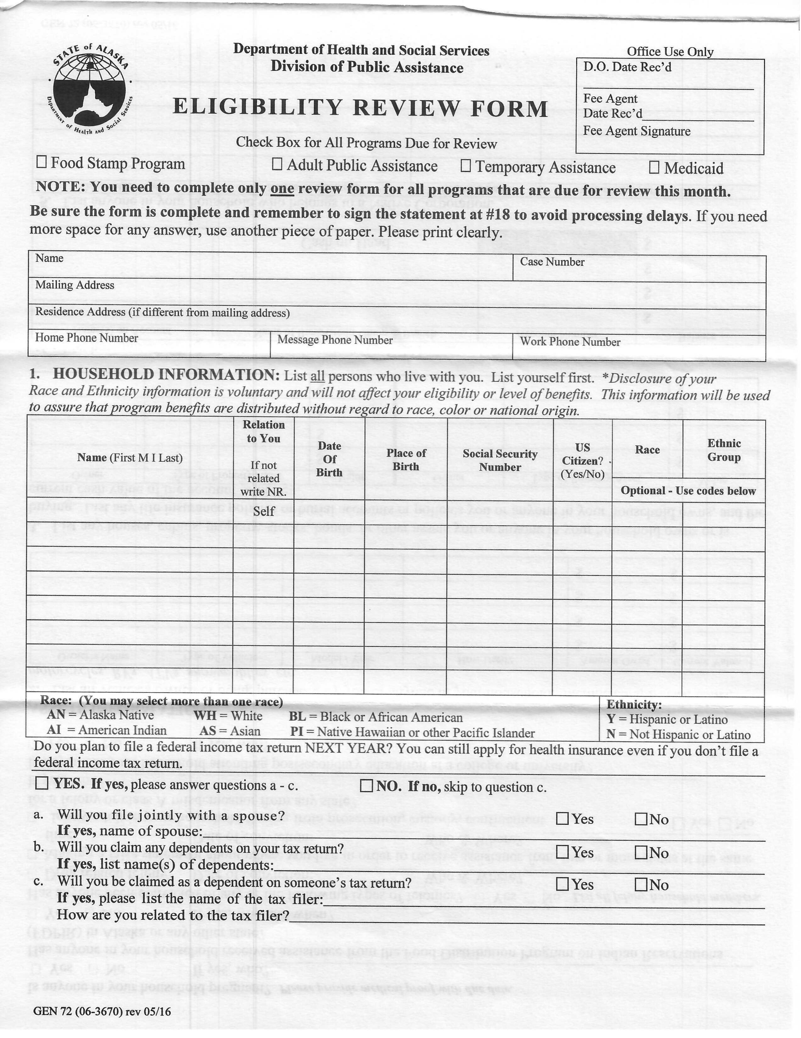
Medicaid Review Form
* Yearly review
* Submit by 5th of month
* Include all documentation
* Verification of submission

Slide 13
Discussion
Scenarios
Questions
Thank you for your participation.

