Slide 1
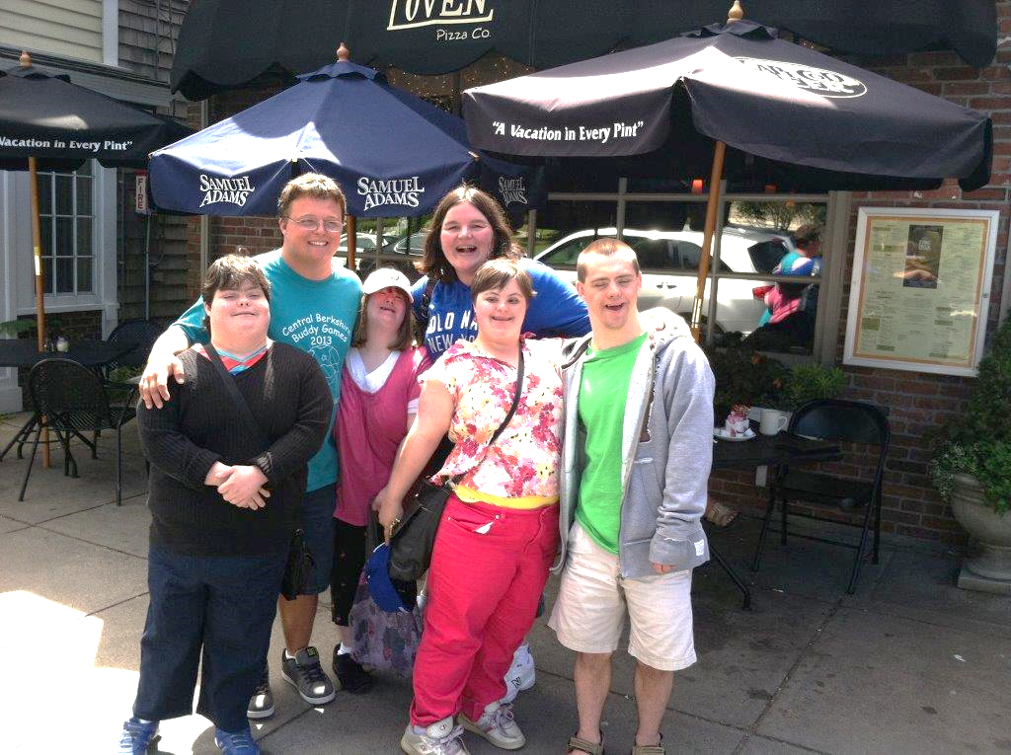
Massachusetts Supported Decision-Making Pilot Project -- Outcomes Center for Public Representation

Slide 2
Massachusetts SDM Pilot
Partnership: CPR, Nonotuck Resource Associates, 4 other human services providers
Individuals with I/DD enter into Agreements with supporters in areas such as health, relationships, finances, employment
CPR provides legal representation as necessary
Agency care managers act as liaisons between the individual, his/her network and the community
Care managers monitor
Independent evaluation of first two years with grant from OSF Other foundations support since then

Slide 3
Massachusetts SDM Pilot
The first 10 adults used shared living, 24 to 79 years old, with different disabilities and varying levels of support.
As many as 25 more adults by the middle of next year (2019).
2 original participants have guardians & who support change to SDM from guardianship
SDM networks of 2 to 10 supporters: parents, siblings, grandparents, aunts, past & current providers

Slide 4
Amanda’s SDM Arrangement
Decision Support Areas:
Health care, Legal, Finances, Home and Personal Life
Chose 4 Supporters:
Mother
Live in caregiver since 2009
Respite worker
Notes:
Hi my name is Amanda.
I live with Sandy. Sandy takes Care of me.
I live with her and her two kids Malya and Craig, Eddie her husband and his kid Adea.
Sandy is 1 of my supporters.
Sandy has also helped me be in her family.
This past November, I was a Bridesmaid in her wedding.
I love Sandy because she has teached me skills to be honest with my feelings and choices.
I love our Family vacations and our time together. I really can't picture my life without my home girl.
On my Support team for SDM, I have Maggy, Sandy, Diane, and my mother. I think supportive decision making helps me because I regularly look to Maggy and Sandy for Support and if I am with Diane i will speak to her. I speak to my mom if I need to too as well.
Supportive Decision making has helped me show that my decision is important.

Slide 5
ONE OUTCOME: TERMINATION OF CORY’S GUARDIANSHIP
Reluctant family encouraged by school & state agencies to be guardians when he turned 18.
5 years later SDM provided an alternative.
Also signed DPOA and AD
Clinicians testified he was capable of making own decisions with support
Court discharged the guardianship in 2015, finding that with support he can make his own decisions. .

Slide 6
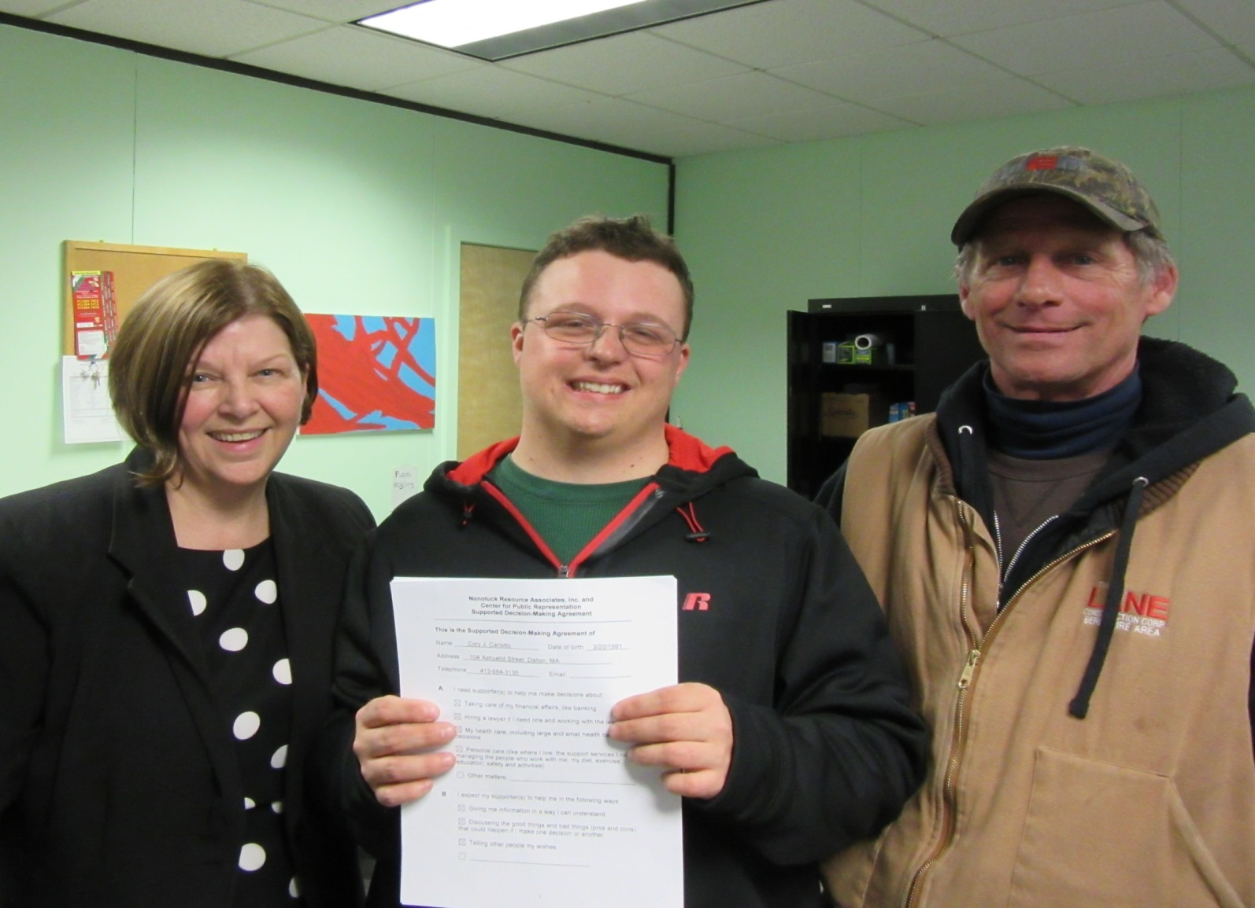

Slide 7
Role of SDM Supporter
Support person’s decision-making by:
One-on-one conversations laying out pros and cons
Demonstration and role-playing
Lots of meetings! Lots of conversations!
Know how person makes decisions (for example, wait 6 minutes for Amanda’s response)
Respect person’s values and preferences … and decisions

Slide 8
SDM Experience to Date
Implementation lessons learned to date
Types of decisions SDM used
Receptiveness of community members

Slide 9
Did SDM place individuals at risk of abuse, neglect or exploitation?
Evaluation Finding: SDM adopters did not experience abuse, neglect or financial exploitation through use of SDM.
Pilot participants stated that the structure of SDM – (1) selecting people they can count on to help them make decisions and (2) having more than one supporter – reduces risk of abuse.

Slide 10
Did SDM make a difference for adopters?
Evaluation Finding: Positive changes occurred for SDM adopters who exercised their decision making rights with tailored decision assistance from trusted supporters.
SDM adopters reported increases in:
increased pride
self-confidence
happiness
willingness to try new experiences
taking greater control of their health & mental health care
helping others more
Notes:
Feedback from decision supporters:
Confidence: “She is more confident in herself. She knows more what she wants. When I first met her she was sad due to past life experiences, and not motivated to do things she does now. SDM has helped motivate her. As things go on she is more confident that she is becoming more independent; she is more comfortable in herself. I see her blossoming.”
Esteem: “She’s happier, she has more self-esteem. People listen to her; before she was told what to do.”
Responsibility: “He’s learned all about his medication. He has a lot -- from fish oil to melatonin to anti-anxiety, thyroid, and mood stabilization. I used to do it. He is now taking a more active role with his doctors and psychiatrist.”

Slide 11
Feedback from SDM adopters
It’s really fun. It helps people with disabilities have their independence even though they have support through it all.
It feels so much better because my parents aren’t so in charge of me anymore. I have some independence now.
Feel good. Life is better. Explain to me. Have people I trust and like.
I have a new leaf on family tree.
Helping people with their problems. I help my co-workers. I feel more confidence and stronger.

Slide 12
Resources & References
SDM initiative website: www.supporteddecisions.org
Representation Agreement and other document templates
Brochure
Advisory Council overview
Evaluations
National Core Indicators (NCI): www.nationalcoreindicators.org
National Resource Center: www.supporteddecisionmaking.org

